Slide 1
Unit 6 Parallel Circuits
Part D: Effects of Adding Parallel Branches

Slide 2
What will you learn?
Effects of adding a parallel branch to a parallel connection.

Slide 3
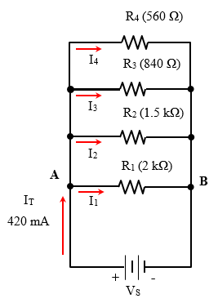
Adding a branch to a parallel circuit
Consider a parallel circuit as shown here.
All 4 branches receive currents from the power source V_{S}.
The total resistance R_{T} can be calculated from the 4 resistors.
Total current I_{T} depends on R_{T} for a constant voltage source V_{S}.
If a new branch is added to the circuit,
R_{T} will decrease, and
I_{T} will increase.

Slide 4

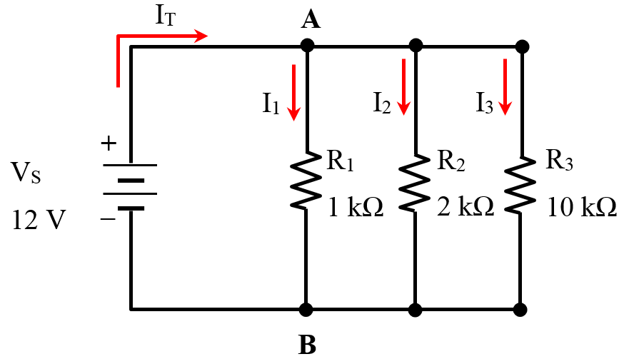

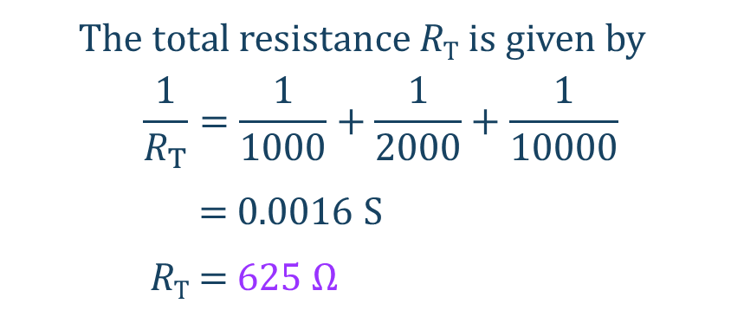
Example 1: Adding a parallel branch
All three branches receive currents from the 12 V voltage supply.
The total resistance R_{T} is given by
$$\frac{1}{R_{T}}=\frac{1}{1000}+\frac{1}{2000}+\frac{1}{10000}$$
= 0.0016 S
R_{T} = 625 Ω
$Total current$,
$$I_{T}=\frac{V_{S}}{R_{T}}=\frac{12 V}{625 Ω}=19.2 mA$$

Slide 5


Example 1: Adding a parallel branch
New total resistance,
$$R_{T\left(new\right)}=R_{T}∥10 kΩ=\frac{R_{T}×10 kΩ}{R_{T}+10 kΩ}=\frac{625×10000}{625+10000}=588 Ω$$
The new branch current,
$$I_{L}=\frac{V_{S}}{R_{L}}=\frac{12 V}{10 kΩ}=1.2 mA$$
I_{T(new)}
I_{L}
New total current I_{T(new)} = I_{T} + I_{L}
I_{T(new)} = 19.2 mA + 1.2 mA
= 20.4 mA
R_{L}
10 kΩ
Alternative solution:
$$I_{T(new)}=\frac{V_{S}}{R_{T(new)}}=\frac{12 V}{0.588}=20.4 mA$$

Slide 6
You have learned that
adding a parallel branch to an existing parallel circuit will
lower the equivalent or total resistance, and
increase the total current flowing into the circuit if the circuit is connected to a constant voltage source.

Slide 7
Coming Up Next
Series-Parallel Circuits

